Slide 1
The Literate Programmer:
Cargo Cult Open Source
Wes Chow
Cortico @ MIT Media Lab
@weschow

Slide 2
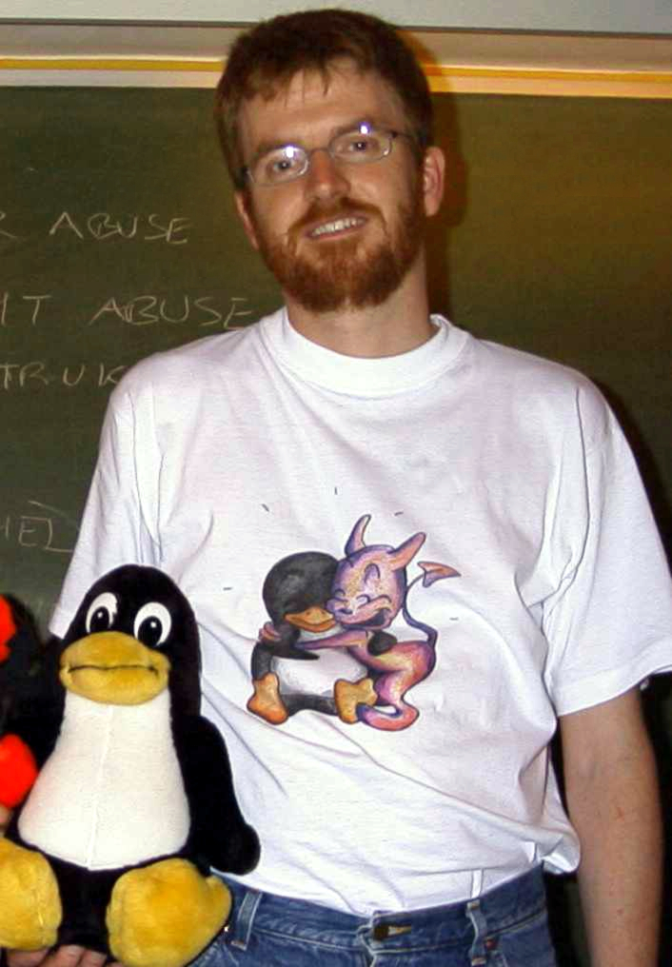
Poul-Henning Kamp
Notes:
Poul-Henning Kamp, 3 things he’s done
We start this story with this fellow: Poul-Henning Kamp. He’s a notable FreeBSD developer, probably reaching into your lives in ways you don’t realize, even if you don’t run FreeBSD. I’ll mention just three of the things he’s done, amongst many amazing things, and dive deeper into one.

Slide 3
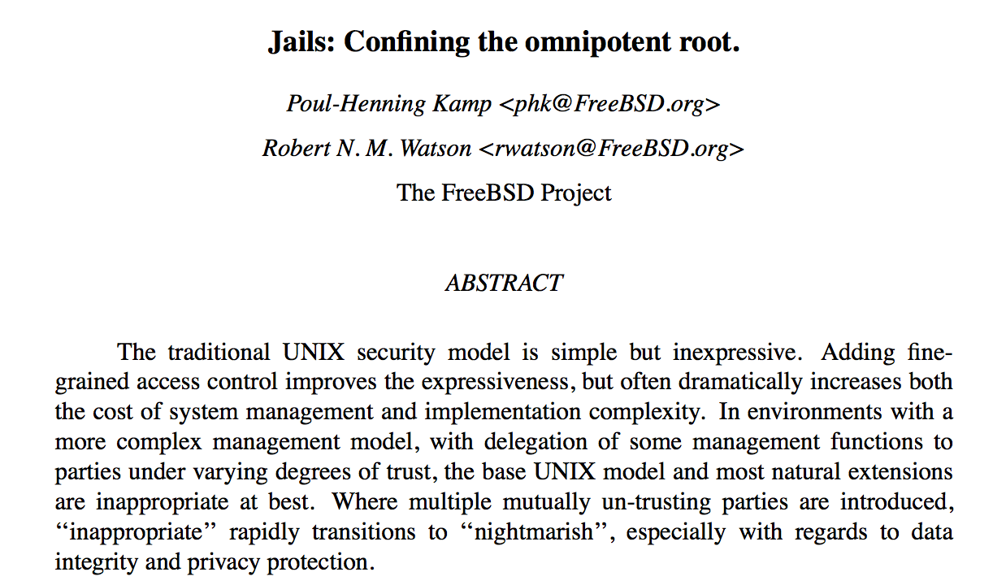
1. FreeBSD Jails (2000)
Notes:
1. PHK along with Rob Watson developed FreeBSD Jails, which was the first widely used implementation of container technology. This was somewhere around 2000. Solaris followed with Zones in 2005, Linux cgroups (predecessor to containers and Docker) in 2007. Docker in 2013, a full 13 years after Jails.
https://docs.freebsd.org/44doc/papers/jail/jail.ps.gz

Slide 4
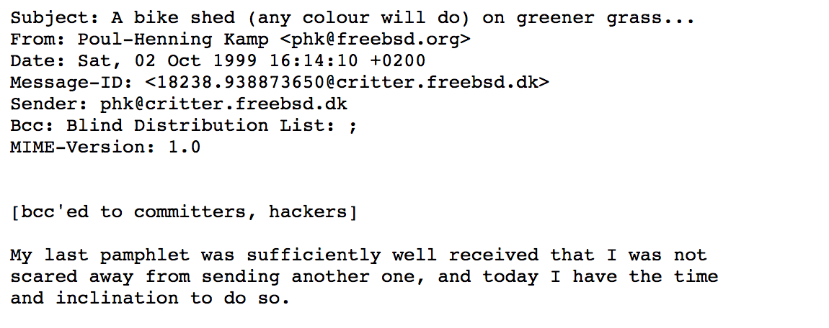
2. Bikeshedding
Notes:
2. He invented the term bikeshedding, to mean a cacophony of opinions that surround the most trivial proposals. He said that the more trivial an issue, the more likely someone would think they know enough to have an opinion, and so the more arguing. “We need a bikeshed,” he said, “it doesn’t matter what color.”
https://shed.bike/

Slide 5

3. Varnish
Notes:
3. Finally, he wrote Varnish, the reverse caching proxy.

Slide 6
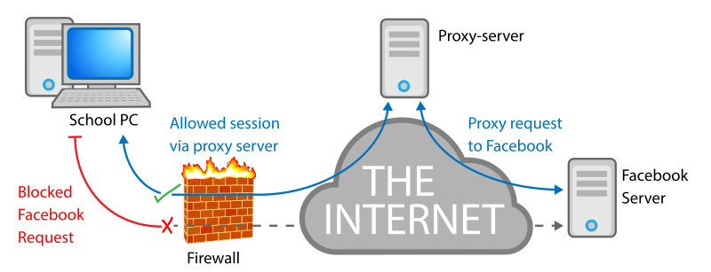
Web Proxy
Notes:
I always thought reverse proxy was a funny name -- it’s relative from your point of view, so it’s easy to get it mixed up.
Web Proxy purpose
A web proxy is something that I bet none of you have to deal with these days. But in the olden days (or bigger corporations), for various performance and security reasons, all bytes your workstation wanted from the internet had to be routed through a company controlled server, called a proxy. So it’s an intermediate step that requests initiating from the inside of the office hop through to get data from the outside.
https://en.wikipedia.org/wiki/Proxy_server#Web_proxy_servers

Slide 7
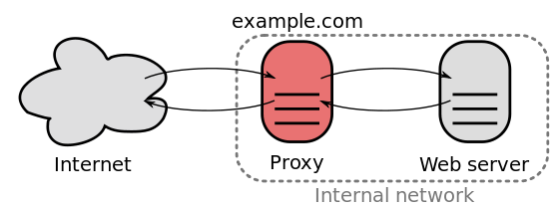
Reverse Proxy
Notes:
A reverse proxy is the opposite -- requests initiating from the outside going through an intermediate step to get data from the inside.

Slide 8

Squid
Notes:
Squid, proxy that caches
In the olden days, everybody used this piece of software called Squid. It was originally written as a proxy, meaning it intercepted requests initiating from the inside going out to the internet. It caches frequently requested pages, and can also do some header manipulation. Because it caches, it keeps careful track of how much memory it’s using and moves objects to and from disk into ram.
Squid, the reverse proxy
Because reverse proxying looks kind of like a regular caching proxy, Squid picked up features to act as a cache for requests initiating from the public into the corporate system. This is, of course, super useful for performance -- why hit your backend web servers when you’re mostly serving the same content over and over?

Slide 9
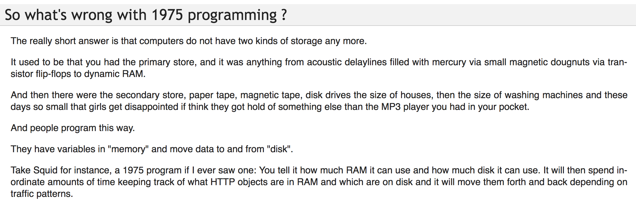
1975 Programming
Notes:
Varnish vs Squid
PHK’s Varnish caching reverse proxy competes with Squid only for that use case. PHK looked at the design of Squid, and how it manually manges a bunch of memory, and thought “you know all this logic is replicated in the way that operating systems handle memory, so why duplicate it in the application?”
http://varnish-cache.org/docs/trunk/phk/notes.html

Slide 10
Language Memory Allocation Hierarchy
By instance / object (Python, Ruby, Java, …)
By array (C)
By page (we’ll get to this…)
Notes:
How does the operating system handle memory?
Python / Ruby / Java, instance allocation
If you use a high level language such as Python, Ruby, or Java, you’re accustomed to thinking about memory allocation in terms of object allocation. You say, “carve out enough space for an instance of class X.”
C allocation / multiple byte array
If you go down a level of abstraction, you’ll find that these objects are represented by essentially contiguous arrays of bytes. In C land, you don’t allocate objects, but rather you allocate multiple chunks of contiguous bytes of arbitrary size.
RAM is single array
RAM in computers is represented as a single big array of bytes. So the question is, how do you get from the application asking for a chunk of bytes to carving it out from RAM?
Single Address Space, programs do what they want
In the olden days, programs would share the same address space. This means that the computer knows it has RAM that can be accessed as bytes 0 to, say, 65535, and when a program runs, it can start reading and writing memory wherever it wants. This is fine if there’s a single program running on the machine, and if you program in embedded systems like the Arduino, this is still sometimes the case.

Slide 11
The Allocation Dance
Program A: “I want 800 bytes.”
OS: Take [0 - 799]
Program B: “I want 1000 bytes.”
OS: Take [800 - 1799]
Program A: “I want 30 bytes.”
OS: Take [1800 - 1829]
A owns [0 - 799], [1800 - 1829]
B owns [800-1799]
Notes:
Single Address Space, programs share?
But it’s bad when you have multiple programs that are trying to run simultaneously. You want to protect programs from messing with each other.
So imagine that you’ve got this array of bytes, and two programs start up. Suppose you can allocate some bytes to one program, some bytes to another. But how do you tell the programs which bytes are theirs? What sort of a structure does that look like? What happens if A release 0-799 but then tries to access it anyway? How do you keep track of free chunks? It can get complicated.

Slide 12
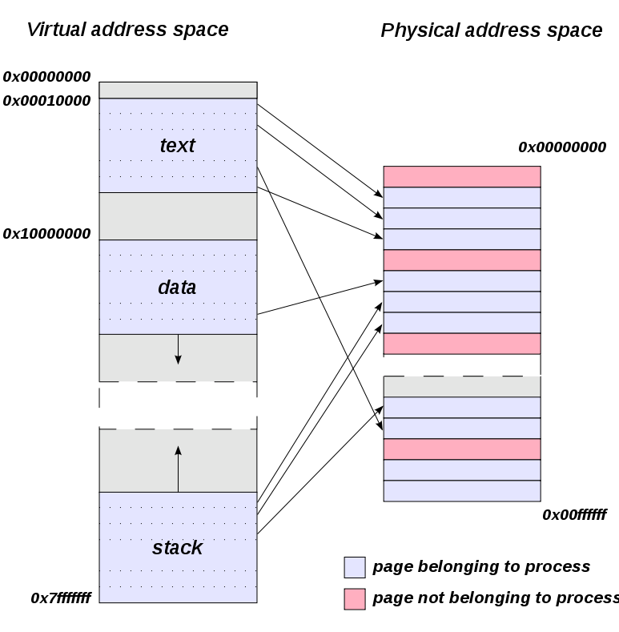
Virtual Addressing
Notes:
Virtual Addressing, mid 80’s
What happened then is we inserted a layer of abstraction called virtual addressing, and with some help from the CPU we swept this mess out of the room. In the Intel line of processors, this happened at the 80386, sometime in the mid 80’s.
Seemingly infinite array from #0
With virtual addressing, we changed the way that programs understand their memory. Previously, two programs would share the same physical array of bytes, but now with virtual addressing they were both assigned a seemingly infinite sequence of bytes starting at #0. So just to repeat, now two programs would both be allocated an infinite amount of memory starting at index 0.
But two programs accessing index #0?
But what if program A accesses index 0, and B access index 0 -- we don’t want those to be the same bytes. What virtual addressing says is the operating system will keep track of a mapping of program A’s 0 to a physical address, say byte 4096, and program B’s 0 to a different physical address, say 8192.
This means we can perform some neat tricks.
Tracking of which chunks of memory a program has becomes the problem of the OS and not the application. So the application can just assume that it has an address space starting at 0 and stretching to infinity.
The operating system doesn’t have to assign a mapping from one virtual address to another until it’s needed.
A virtual address doesn’t even have to point to a location in memory! This is super cool. It could point to a location somewhere else, like on disk, or even a remote machine connected by a network.
https://en.wikipedia.org/wiki/Address_space

Slide 13
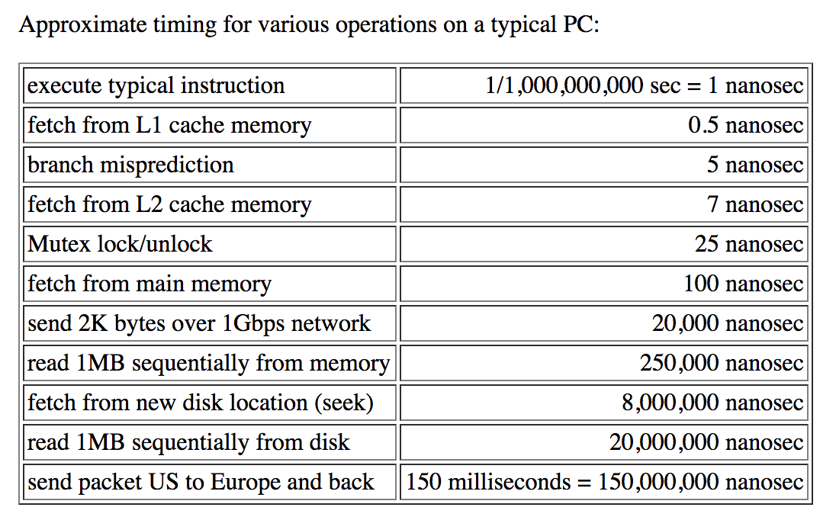
Numbers You Should Know
Notes:
But accessing a byte off disk is really slow compared to memory.
See table, disk seek is 4 orders of magnitude slower than memory
Programs aren’t expecting that, so the OS can do this tricky thing of taking a byte on disk and then migrating it into memory and updating its mapping, completely transparent to the program. And it can do this in bulk, so amortized average request times aren’t so bad. This is called paging, and we’ll talk about it more in depth later. Let’s go back to how programs manage this 0 indexed virtual address space.
http://norvig.com/21-days.html#answers

Slide 14
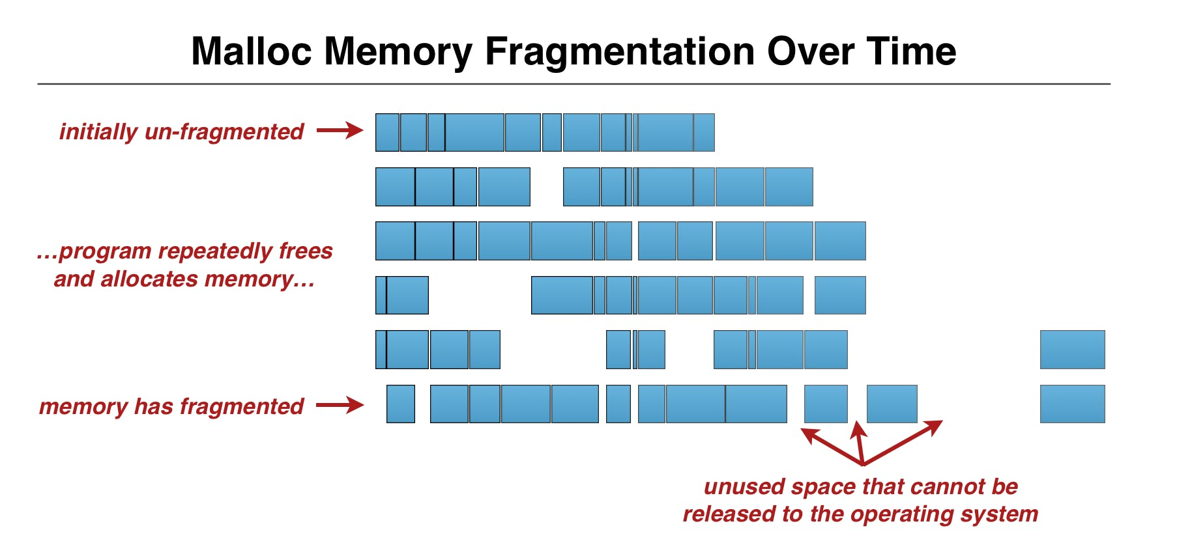
Memory Fragmentation
Notes:
In C land you can ask for arbitrary sized chunks of memory. Now imagine over the course of a long running program, you may ask for chunks of different sizes, free them up, ask for more chunks of different sizes, and over time your memory starts to look like swiss cheese with holes in it. Now burn that into your brain, because it’ll become important later.
https://collectiveidea.com/blog/archives/2015/02/19/optimizing-rails-for-memory-usage-part-2-tuning-the-gc
3D Flight Simulator, Point type
But it doesn’t happen like this in practice. Most programs are asking for certain sized chunks more often than others. Suppose for instance you have a 3D flight simulator. Well you’ve got a instances of type Point in there, which consists of an X, Y, and Z floating point number. All those points are the same size, so it makes sense that you might want to write a memory allocator that’s optimized for keeping track of 3D points.
Trick: push hard decisions to business logic (application)
This is domain knowledge the operating system doesn’t have, so the ideal thing is to design a algorithm that doesn’t require the OS to know about the app’s usage, and push the hard logic into the app. What does the operating system give the app when the app asks for 27 bytes of memory?
Pages
The trick here is that the app isn’t allowed to ask for 27 bytes of memory. Rather, it asks for entire pages of memory, which is basically a fixed size array of bytes, usually something around 4k. So the program says “I need a page of RAM”, the OS says “sure, here it is, go nuts”, and it’s up to the program to decide how to split that 4k page into 27 byte chunks for whatever it needs.
How a program decides to carve up seemingly arbitrary chunks of bytes from 4k pages is a subject for a different talk. These are called memory allocators and there are a variety of them. It’s not well known, but in a C program on Unix you can replace these allocators with different versions that have different performance characteristics. This makes sense -- pick the memory allocator best suited for your application’s allocation pattern.
Free Pages List, Disk
Since the operating system is always handing out pages of memory, regardless of applications, it’s a much easier bookkeeping problem. It keeps simply a list of free pages, and pages that it’s assigned to apps. It can take these pages, and like I mentioned before, migrate them onto disk if they’re not being accessed. And then it can bring them back into memory when they do get accessed.
Pre-Fetch
The OS has all sorts of fancy logic for guessing when it’s safe to eject a page out of ram to disk, and when it might want to pre-fetch a block from disk into RAM. This is, in a sense, the Squid problem -- we need to make guesses as to which objects (in Squid) or pages (in the OS) are frequently accessed, and make sure those stay in fast RAM.
Another thing of note is that the APIs that RAM and disk expose to the operating system are in pages anyway. So it gets to pass through some of the access logic, and also gets special hardware support (like the CPU can tell it if a program access a fictional page).

Slide 15
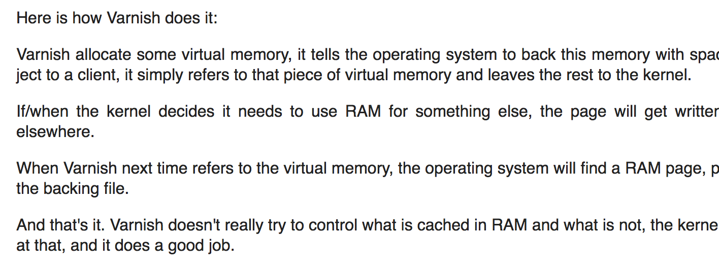
1975 Programming
Notes:
Varnish throws out memory management, let OS do the heavy lifting
So PHK looked at this and figured, well why duplicate the work? We’ll throw out the memory management logic from Squid and instead use the OS paging mechanism to make sure stuff loads fast. PHK, who has a history of writing some notorious emails, laid out the architecture of Varnish in a 2006 essay in which he said that he wanted to bring a “1975 style program (Squid)” to a 2006 style architecture. In it, he basically said “let the operating system do the heavy lifting of shuttling memory to/from disk.”
Squid keeps structures around
So to clarify, Squid keeps data structures and statistics around to figure out which objects should be in fast RAM, and which objects should get saved out to disk. Varnish doesn’t do this. Varnish says, “just allocate the object” and then allow the OS to figure out whether or not the page the object is in gets moved to disk or stays in RAM.
Varnish outperformed
The result was amazing. Varnish way outperformed Squid right off the bat for reverse proxy caching. Squid has gotten better since, but it’s too late. I don’t know of anybody who runs Squid these days -- it’s all Varnish. All of Fastly, for instance, is powered by Varnish.

Slide 16

Notes:
Fast forward a bit to roughly 2008 or 2009, and we see that the hottest new database on the block is MongoDB.
10gen and ShopWiki
MongoDB, created by a company called 10gen at the time, was the database of a set of web development tools they sold. This was all yanked out of another company called ShopWiki. Btw, ShopWiki has one of the most dastardly clever business models. I don’t know if they still exist, but they used to buy up misspelled domains, and they were able to generate online stores on the fly based off a few keywords extracted from the domains.
Web development platform, but db is what people wanted
Anyway, they had this great web development platform which included a database, and they thought to spin off the entire platform into a separate company, 10gen. After some failure in selling the platform, 10gen discovered that the database was the only product that people really liked, so they focused on just that. A couple years ago they made the transition symbolically complete by renaming the company from 10gen to MongoDB.

Slide 17
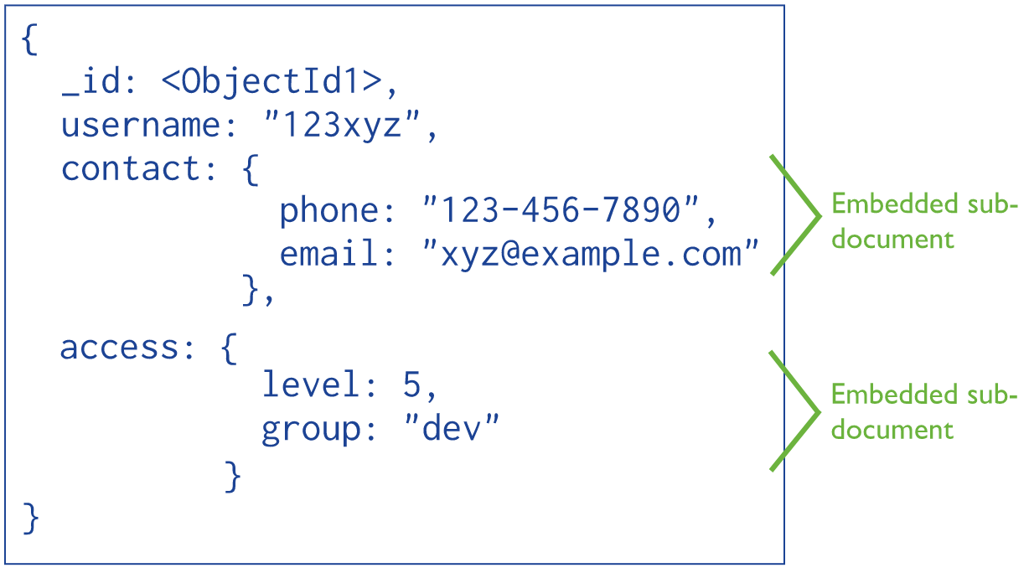
Document Store
Notes:
Document store, kv lookup on IDs plus secondary index
MongoDB is a document store, which under its definition is basically json objects with unique ids, plus some secondary index functionality.
Explain diagram. What is a secondary index? Mongo is kv store, not real db.
The key part here is that MongoDB really thought of itself as a fancy key value store for a while. The design of it meant that, for instance, secondary indexes lagged the primary index slightly. They tried various things to make it big data, like embedded mapreduce (using Javascript as the execution language of all things!), and then they tried to get everybody off of that and onto the aggregation framework, which I think still exists but I have yet to meet anybody who actually uses it.
Point is, this is a database that has evolved over time from kv store but did not start with a single cohesive design.
Big Data, web scale, Varnish reference
MongoDB, latching onto the burgeoning big data movement (it was not yet a parody and was a real thing at the time), got “mongo” from “humongous”, and implemented a memory management model very similar to Varnish. In fact, I believe they linked to the Varnish docs though I was unable to verify this. They made the same argument that modern OS memory management was better than manually handling memory in the application.
Except remember the reason why the operating system gives pages of memory to applications rather than sizes the app wants? It’s because the operating system, in general, can’t provide a generally good method for avoiding swiss cheese, because it doesn’t have knowledge of the application workload.
https://docs.mongodb.com/manual/core/data-model-design/

Slide 18
Least Recently Used
Discards the least recently used items first.
In other words, keep what you last accessed.
Notes:
Why is it ok for Varnish to use OS page cache?
It turns out for key value stores, like Varnish, the algorithm the OS uses to efficiently handle page management is Least Recently Used and works well in practice. The question here is, when the OS needs to move a page from disk into RAM, and move a page from RAM out to disk, how does it pick which page in RAM to eject? LRU says, order all of the pages by the last time they were accessed, and eject the one that was last accessed longest ago.
In other words, keep pages in RAM that look like they keep getting accessed. This is generally very good for Varnish -- web pages most recently accessed are more likely to be accessed again. And for Mongo, as a key value store, it may be good as well -- documents most recently looked up may be more likely to be looked up again.

Slide 19
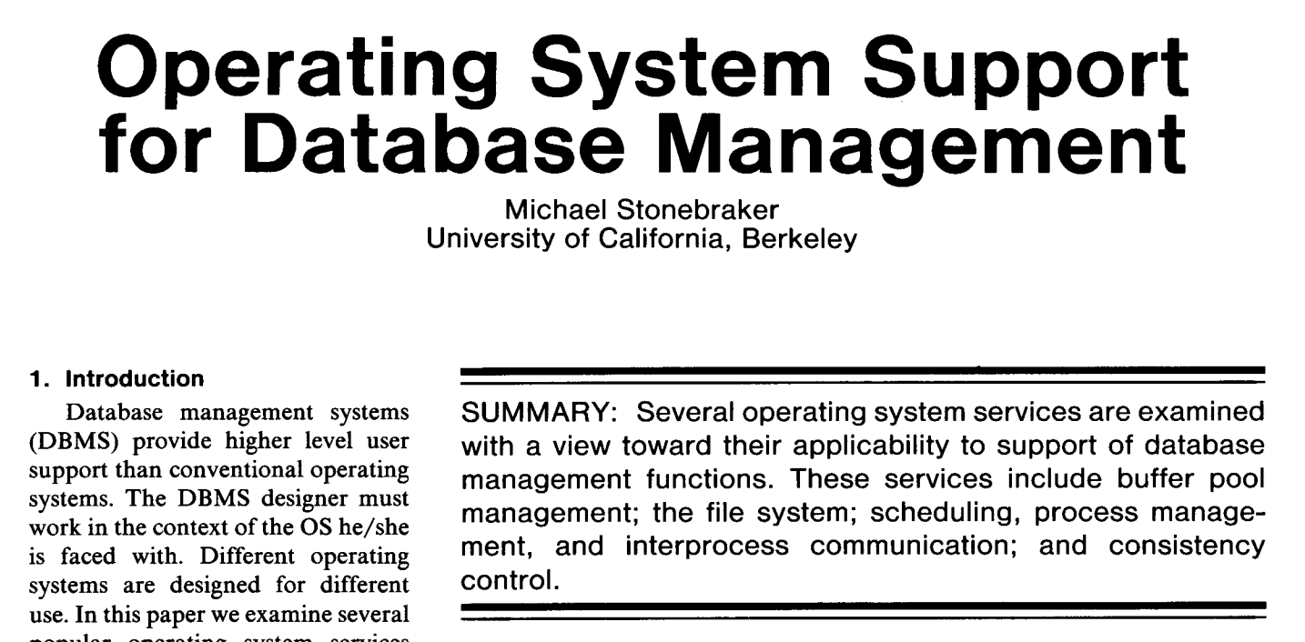
Stonebraker, 1981
Notes:
Why is it NOT ok for Mongo?
But for secondary indexes, ie scanning across a range of documents or looking up data not on recency, LRU turns out to be a bad thing. Michael Stonebraker, in 1981 argued this (Operating System Support for Database Management), and subsequent databases work in the 80’s (An Evaluation of Buffer Management Strategies, Chou & DeWitt) showed that manually managing memory and disk access gives better performance.
https://pdfs.semanticscholar.org/b87e/aa70186ac8bd7f371fd10c4e768201575889.pdf

Slide 20
Intuition: documents not ordered by time
{ _id: 1000, username: ‘carol’, phone: ‘917-123-1000’ }
{ _id: 1001, username: ‘alice’, phone: ‘917-123-1001’ }
{ _id: 1002, username: ‘zed’, phone: ‘917-123-1002’ }
…
{ _id: 9999, username: ‘bob’, phone: ‘917-123-9999’ }
Notes:
Intuition
Why is this? The intuition is this. On secondary index scans, your documents are usually not ordered by last time accessed. They’re ordered by some property of the document that is independent of the time that document was accessed.
Example
Here’s a simple example. Suppose that you have a collection of documents that contain website user information, for instance:
{ _id: 1000, username: ‘carol’, phone: ‘917-123-1000’ }
{ _id: 1001, username: ‘alice’, phone: ‘917-123-1001’ }
{ _id: 1002, username: ‘zed’, phone: ‘917-123-1002’ }
…
{ _id: 9999, username: ‘bob’, phone: ‘917-123-9999’ }
The different colors represent different pages. So 1000 and 1001 are in the same chunk of memory, and 9999 is in a different chunk.
Remember, chunks of memory pulled in fixed size pages one at a time
The _id increases on every new user, so the documents are ordered in the memory pages in the order in which users sign up.
List users page, range query by username
But suppose we have a “list users” page, and we want to show the first 100 users alphabetically. Well, we’d build a secondary index on username, and then do a range query ordered by username limit 100. Under the naive let-memory-handle-it, we’d look up alice first, pulling in the entire green page, then bob, pulling in the entire blue page.
Context switch
That doesn’t sound so bad right? But what happens if another request comes in right at this instance, and the OS decides to switch to that one and give it a bit of CPU time. It’s possible that this process will need some memory, and the OS then has to evict a page from RAM and send it to disk. It uses LRU, and the green page is the oldest page. So it moves it to disk.
Context switch back
Then we switch back to the original request, and have to look up the contents of Carol. This bring green back into memory. This moving of stuff to and from disk is really expensive -- remember that it’s 4 orders of magnitude slower to access disk than memory.
But the DB can be smart
But all is not lost. With some effort, the database can be smart about tracking the location of these documents. It can figure out “I know that two of my objects, alice and carol, are in the same page so when I look up alice, I should also go ahead and look up carol. Then I can look up bob, and sort the results in memory later.”
What’s more, if the database can guess that it’ll need blue right after green, it can fetch green, then start sorting green in memory, and at the same time issue a fetch for blue. These can happen independently, because the sorting of green in memory is a CPU bound operation, whereas the looking up of the next page is a IO thing. It uses different parts of the machine.
This is business logic
Notably, this pre-fetching behavior is something that only the application has a shot at predicting. The operating system understands nothing about the contents of the green and blue pages.
MongoDB, then, decided to throw out decades of databases research saying OS memory handling wasn’t good enough, and argued based off the success of a different system with different usage patterns that OS memory management was good enough.

Slide 21
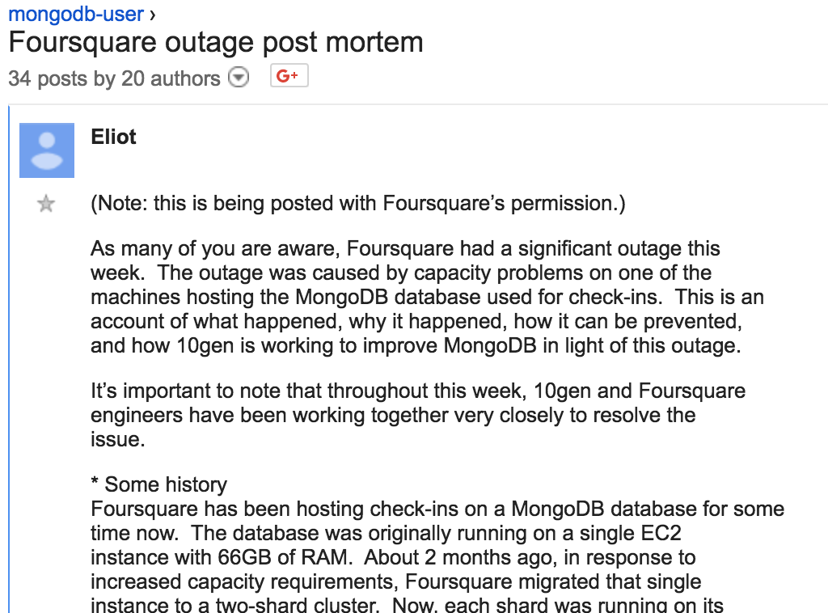
Foursquare Outage
Notes:
Epic Foursquare
Then came the infamous Foursquare outage in 2010. Remember Foursquare? This was epic, and extreme kudos to MongoDB and Foursquare for being so public about it. I sound like I’m shitting on MongoDB, but I consider their postmortem one of the most important devops readings in modern web development.
Foursquare went dark for 11 hours because one of their Mongo database exceeded the amount of ram available on the machine. What happened was Mongo’s strategy of having the OS page in and out caused a performance issue that made a substantial subset of queries orders of magnitude slower.
Migrate data off
Foursquare rooted out the cause quickly, then brought up a new Mongo database and started migrating some of the data off of it to alleviate memory pressure on the main database. To their surprise, this didn’t help anything.
https://groups.google.com/forum/#!topic/mongodb-user/UoqU8ofp134

Slide 22
Swiss Cheese
{ _id: 1000, username: ‘carol’, phone: ‘917-123-1000’ }
{ _id: 1001, username: ‘alice’, phone: ‘917-123-1001’ }
{ _id: 1002, username: ‘zed’, phone: ‘917-123-1002’ }
…
{ _id: 9999, username: ‘bob’, phone: ‘917-123-9999’ }
…
{ _id: 1000, username: ‘carol’, phone: ‘917-123-1000’ }
{ [deleted] }
{ _id: 1002, username: ‘zed’, phone: ‘917-123-1002’ }
…
{ _id: 9999, username: ‘bob’, phone: ‘917-123-9999’ }
…
Notes:
The Swiss Cheese problem
In the very detailed post mortem, Mongo explained that this is because of the memory allocation strategy. As documents moved off one server and onto another, Mongo would “free” that little chunk of memory. But because all these documents were slightly different sizes, not much of that memory actually became free and reused.
Pages become more wasted (fragmented)
Not only that, the operating system paging mechanism brings an entire page in and out of memory regardless of how much of that page is actually being used. So even if all but one of the documents in a page get migrated off, as soon as the database needs access to that one last document, then the entire page gets pulled off disk and takes up space in memory.
Now if Mongo were managing its own memory, it might know that that single page is very ineffectively used, and immediately free up that page once it’s done with that one document. But the OS doesn’t know this, and so can’t have a coherent cache eviction strategy that takes into account application behavior.
The fix was to essentially rewrite all the documents in-place, thereby compacting all the non-delete documents into a smaller set of pages.

Slide 23

MongoDB is Web Scale
Notes:
There’s some irony in this, because MongoDB was marketed as being able to handle huge amounts of data, but more accurately, it could handle a lot of kv lookups, but not much else. And this was a case where its memory architecture, chosen for performance and scale reasons, was precisely why it failed.
I’ll quickly contrast this to a system like Postgres, which came out of the Ingres project led by Michael Stonebraker, the guy who wrote that 1981 paper about how LRU isn’t a good mechanism. Postgres does two things relevant to this discussion.
It manages pages very carefully and on a query against a secondary index, it plans out the sequence that it’s going to fetch pages off disk.
Every row in Postgres is the same size in bytes. This is a direct consequence of having a well defined schema. Most data has some sort of structure like this. Mongo could very well have required a schema definition, but still retained the document nature and collection structure. You really want schemas.. They give you all sorts of nice checks.

Slide 24
What’s Going On?
MongoDB transitioned from a dogfooded database into a VC backed venture.
Data is inertia.
10gen didn’t have any big data use cases.
Notes:
Let’s end the technical part of this talk and dive into some ethics here. It’s unfair to expect that Mongo really knows your usage pattern, and it’s actually a very hard problem to define a general model that works for most applications. My beef with it all has to do with the marketing around the project.
I think there are a couple of things in play:
MongoDB transitioned from a dogfooded database into a VC backed venture.
Data is inertia.
10gen didn’t have any big data use cases.
The incentive structures for VC backed companies are go big or bust.
There’s also the general trend, I’m sure you see this in all of your companies, that you first adopt tech that’s open source, and then maybe you adopt tech that’s free but closed source, and then maybe you pay for stuff that’s closed source. Stonebraker argues this about his new database project, VoltDB, that as a database vendor the only way you can do business is to offer your software for free as in beer to accumulate a wide base of users, and then monetize a small number of them.
So point #1 means that Mongo’s business strategy was to make the thing popular, not to design it well. Schemaless design is useful when you’re prototyping, but it kills you when you have a lot of data at scale. So you get early adoption, and then eventual disillusionment.
If a dev gets to the disillusionment phase, then why not just switch off of the system? Because #2, data is inertia.
By the time you’re at scale and you see cracks in the design, you’ve adopted an entirely unique data model -- no other database quite matches the Mongo model, unlike SQL for which there are multiple competing systems -- and you have a lot of data. It’s really hard to migrate not only the data but also port the application. So there’s in effect a kind of data lock-in, even though Mongo itself is free as in freedom. Data is inertia.
Early adoption plus vendor lock-in means growth numbers look good. That’s what VCs want.
Third, Mongo stopped getting dogfooded, and as a result something like the Foursquare outage happens. I mean, think about that. Foursquare responded to a full database by adding another node, exactly the reasonable response that you’d get, and when they did that they lost their cluster for 11 hours. Undoubtedly 10gen had tests on bringing up extra nodes, and yet they somehow missed out on a real world use case.

Slide 25
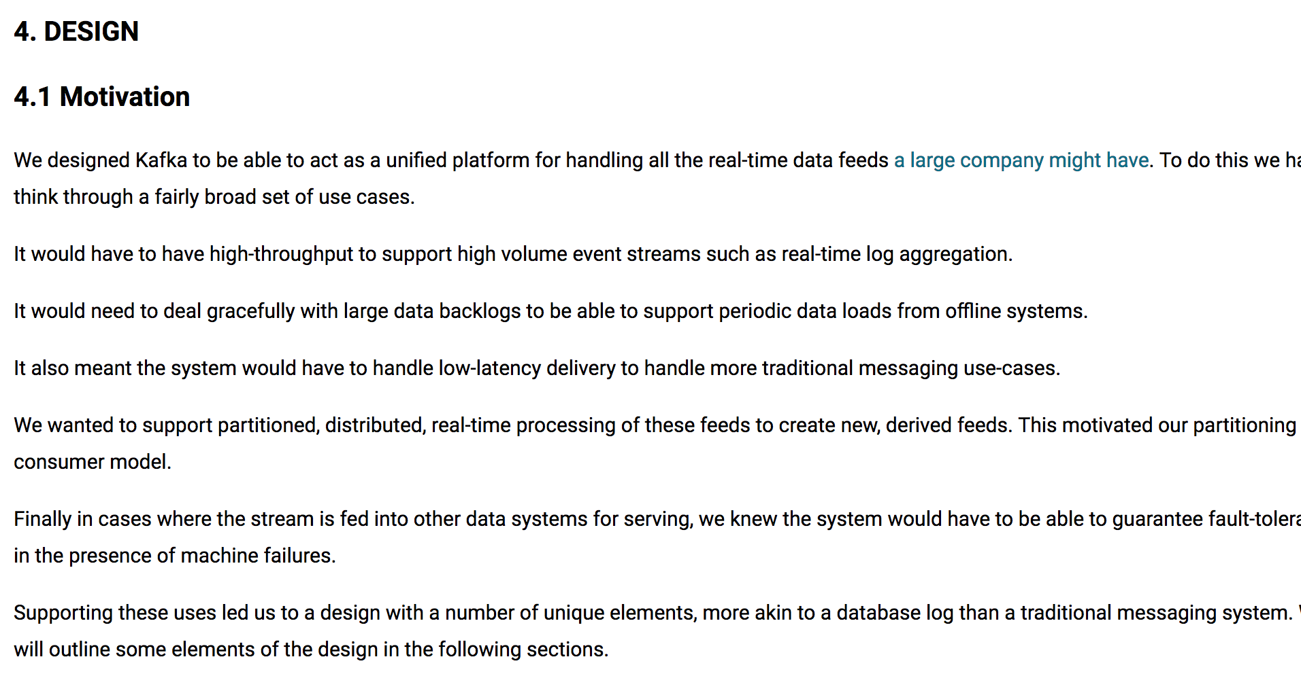
Kafka Design
Notes:
Kafka design doc
I’ll contrast this with Kafka, which was already tested in the real world at big scale before getting released as open source. Kafka is a master class in scalability, and there’s this great design document out there that shows how all the internals work. It has never had issues with scale. It might have other issues, like usability (at the time of release it was deployed by super technically competent folk), but they never lied about this in their marketing.
https://kafka.apache.org/documentation/#majordesignelements

Slide 26
Ethics of...
Vendors & Marketers (and problem statement alignment)
Consumers
Developers
Notes:
What can we do about this?
I think in an ethically minded company, we would align marketing with practice. For instance, modern MongoDB has a big data use case. They have many big data use cases -- their Atlas product is essentially hosted Mongo, and so they now know quite a bit about how to run their stuff in production. Of note, they also threw out all of this memory mapped nonsense and adopted a storage engine, WiredTiger, which does a much better job at managing memory and pages on disk. It should never have been the case that the company could advertise it can handle big production loads when they never actually ran big production loads.
But this is to show, MongoDB, despite a very rough start, is now aligned well and I think a really great company.
But I can’t just shit on the ethics of vendors. What about the ethics of consumers, you and me? Our tendency to use free as in beer and grab software and not pay is what drives software vendors to VC / growth models. There’s a similar thing going on with media -- the tendency to read only free content drives publishers towards advertising models rather than subscription revenue, which aligns the business in weird ways. As a consumer, you want to make sure that you’re paying for quality in some way in order to encourage quality. Free content incentivizes lots of eyeballs with low conversion rates.
And there’s the convenience question. Stonebraker is partially right -- as a vendor you want wide adoption, but he’s thinking of solving a wide set of use cases. But I think the tendency on the Internet is to go for convenience, to move fast and work things out later. Developers are accustomed to downloading installation scripts and piping them directly into a shell for godsakes. How lazy do you have to be to just allow anybody to give you sudo access to your machine? There’s this weird dev culture of laziness being a virtue (Larry Wall, the creator of Perl, says it’s one of the three virtues of programmers). It’s horrendous.
And finally, I think we as software developers have to be ok talking about failure, I’m particularly thinking about failure of our own systems. That Foursquare post mortem was great. When was the last time we got a good deep post mortem like that? When was the last time you wrote a post mortem like that out in the open? I think we have an ethical responsibility to be totally open about failure.

Slide 27

The Cargo Cult
Notes:
I’ll end with Richard Feynman.
Science is about failure, and he talks about how the core of the scientific method is the ability and responsibility to actively try to disprove your own ideas, not just those of others.
Twenty years ago I read his Cargo Cult Science speech-turned-essay, and it really changed the way that I acted and thought about my own career. Feynman talks about the difference between science and advertising by illustrating a Wesson Oil advertisement, which claims that it doesn’t soak through food. Feynman points out that this is indeed true, but actually no oil soaks through food if operated at a certain temperature. And if operated at a different temperature, all oil soaks through food. Now you look at this as engineers and think “right, that’s the difference between marketing and engineering, our marketing department says one thing but our documentation / code tells the truth.”
Feynman talks about a civilization in the South Seas that became accustomed to receiving supplies from Western nations during wartime. Then when the war stopped and the planes stopped coming, they participated in rituals in an attempt to bring the planes back. They made fake headphones with fake sticks, went out to the empty landing strips, and made the motions of landing crews, thinking that’s what it took to bring the planes.
Feynman calls this Cargo Cult Science. It’s the motion or participation in what’s seemingly science but lacks something fundamental. He talks about the history of the oil drop experiment, where scientists would throw out their replications if it didn’t match previous results. But you see, the original experiment was wrong, and it took decades for us to get the charge of an electron right because we kept throwing out the negative results and keeping the positive ones, even though the negative ones were the correct ones.
The scientific community talks openly about problems with incentive structures encouraging bad science -- the system is incentivized to produce positive results, through publishing, journals, getting accepted into conferences. But real progress depends as much on getting negative results as it does from positive results, but the system is rigged in favor of those that produce positive results.
I think in a way we’re in a golden age of Cargo Cult Open Source. We have these communities largely driven by incentive schemes which distort open and community driven development. Acknowledging this is happening is a first step towards fixing it, but even science hasn’t figured it out. I think as developers of open source, and as users of open source, we have to be honest that our actions too may distort true open source.
https://en.wikipedia.org/wiki/Richard_Feynman#/media/File:Richard_Feynman_Los_Alamos_ID_badge.jpg

Slide 28
Principles
Don’t fool yourself.
Don’t fool others.
Notes:
Feynman says the first principle of eliminating Cargo Cult Science is that you must not fool yourself. He also talks about a second principle he doesn’t enumerate explicitly in his essay. He says that as a scientist, you need to have the integrity to bend over backwards to give all information, to explain how you might be wrong, how your data may point to a different conclusion, how your experiment fails. He says the first principle is to not fool yourself, and I will add that the second principle is to not fool others.
As developers, we first have to not fool ourselves. And then we can’t fool others. And I think if you write code for a living, closed or open, you should ask, am I allowed to be honest? Can I provide the information, total and complete, about how my system works well and poorly? When was the last time you went to an open source project’s page and saw links to blog posts about how it failed? There’s no shame in linking to failure. It makes the project stronger. It gives engineers something to solve.

Slide 29
Principles
Don’t fool yourself.
Don’t fool others.
Debate ideas and code, not people.
Notes:
A third principle comes to mind. I recently came across work by Lilliana Mason, a political scientist the University of Maryland, College Park, who talks about polarization and identity politics. She argues that politics becomes contentious when technocratic ideas become intertwined with a person’s identity. If your identity is indistinguishable from, for instance, guns or gender identity, then a debate on gun policy or the definition of gender becomes an attack on your identity. An attack on your identity causes you to psychologically wall up, to get angry and defensive.
For open source developers, especially project founders, the software is a part of their identity. We should aim not to criticize people or corporations but to criticize ideas, but this becomes a difficult proposition if the idea is tied up in an identity. Mongo was never a thing community run to the extent that, say, Python is. Even though Python, up until recently, had a BDFL, the project set up an internal PEP process that focused on the debate of ideas and not on identities. The entire conceit of the Apache philosophy is to move a project from its founders to a sustainable community. The ZeroMQ C4 process is one that prioritizes empowering the community over centralized control. So I suspect that an idea oriented governance structure is something that as consumers we should look for, and something that project founders should ideally aspire to create.
And I think internally, an engineering organization should strive to have idea oriented governance. If an engineer’s identity is tied closely to a subsystem, then the failures of that subsystem become attacks on that individual.
FIXME something about integrity here

Slide 30
“I wish to you the good luck to be somewhere where you are free to maintain the kind of integrity I have described, and where you do not feel forced by a need to maintain your position in the organization, or financial support, or so on, to lose your integrity. May you have that freedom.”
- Richard Feynman, 1974
Notes:
So I’ll end this talk the same way that Feynman ended his. He said
I wish to you the good luck to be somewhere where you are free to maintain the kind of integrity I have described, and where you do not feel forced by a need to maintain your position in the organization, or financial support, or so on, to lose your integrity. May you have that freedom.
http://calteches.library.caltech.edu/51/2/CargoCult.htm

